Slide 1
Fake Detect

Slide 2
Data Overview
Obama
 | # of Videos | Video Length (s) | Total # of Frames
Train Positive |  | 7118 | 207994
Train Negative |  | 3681 | 101819
Test Positive |  | 6720 | 196541
Test Negative (Fake Video) |  | 2791 | 283916
Trump
 | # of Videos | Video Length (s) | Total # of Frames
Train Positive |  | 1207 | 35257
Train Negative |  | 3681 | 101819
Test Positive |  | 1027 | 23838
Test Negative (Fake Video) |  | 1184 | 121328

Slide 3
Feature Sequence = 100 Frame, Overlap = 10 Frame
 | Trump | Obama
All Feature | 0.658025 | 0.30054
Location of the head wrt camera | 0.676117 | 0.29845
Head rotation | 0.819682 | 0.465786
Lip gap/width | 0.984704 | 0.992473
Eye gaze direction | 0.682071 | 0.892383
Eye blink | 0.703402 | 0.875203

Slide 4
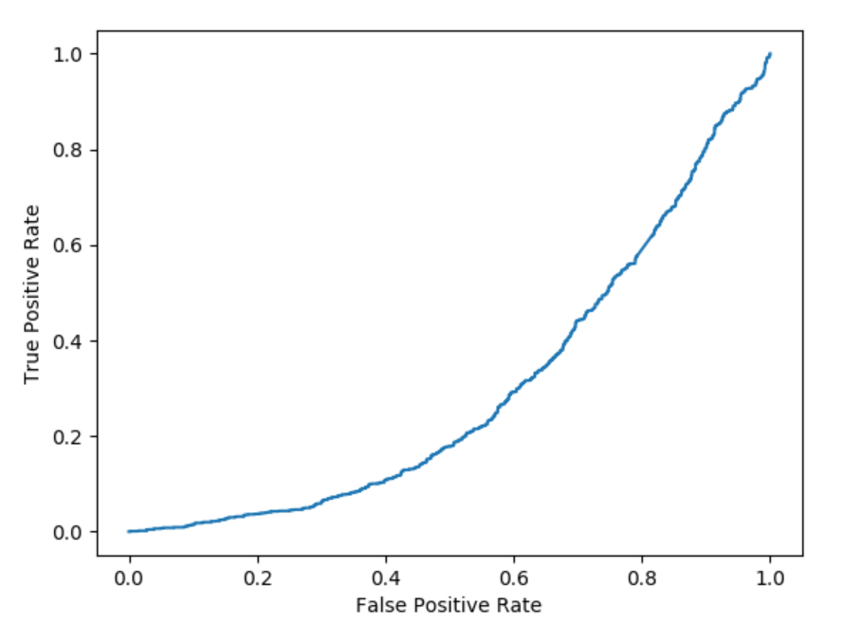
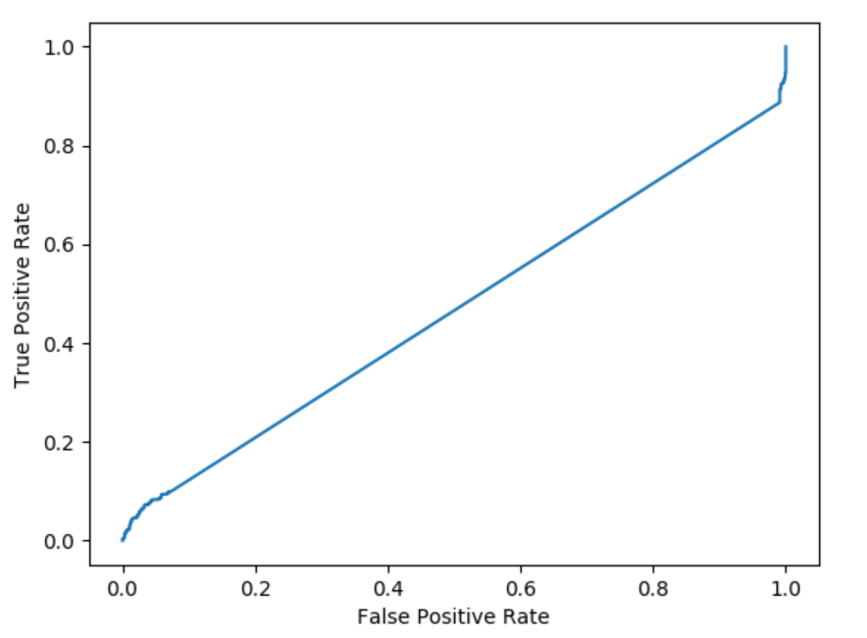
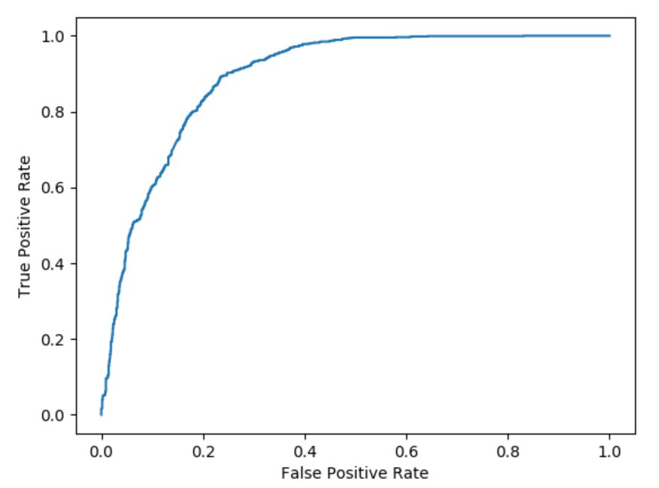
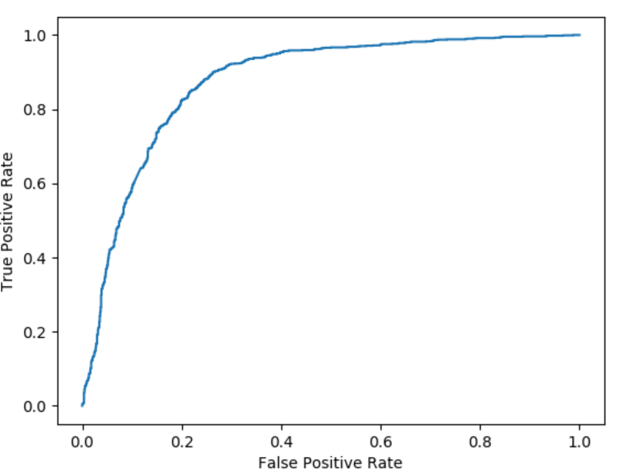
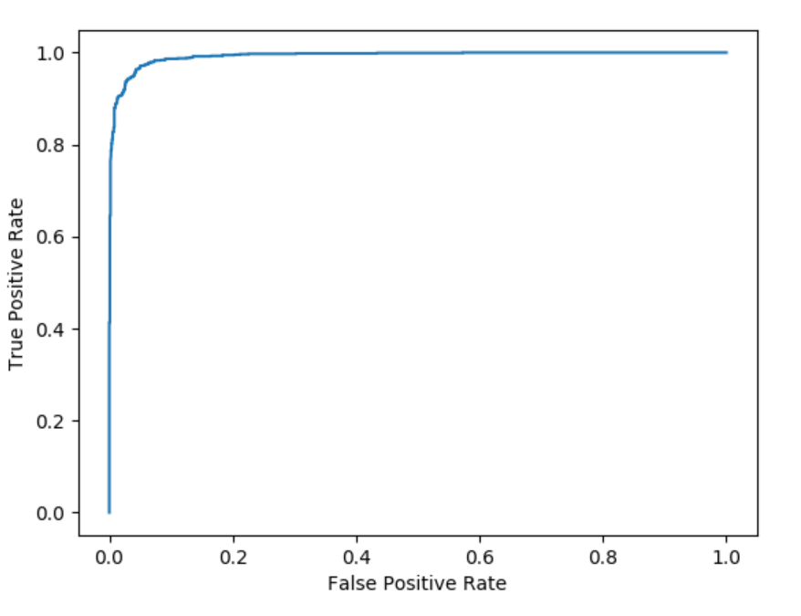
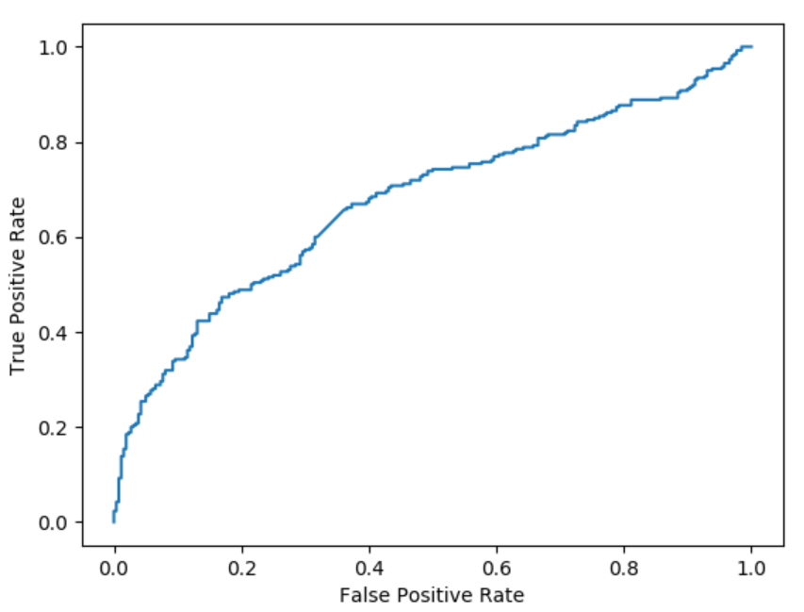
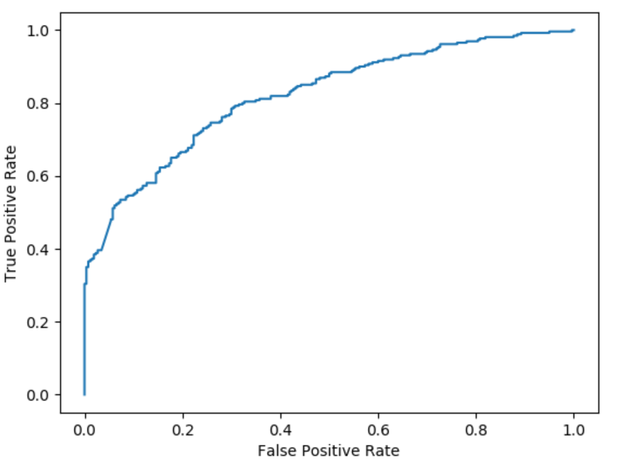
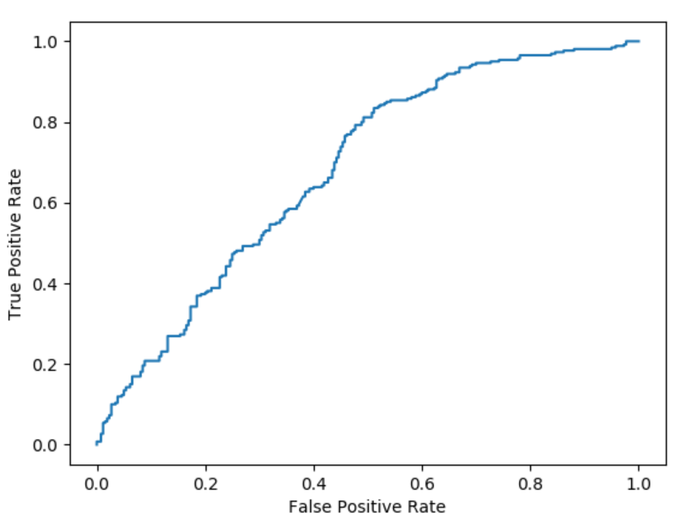
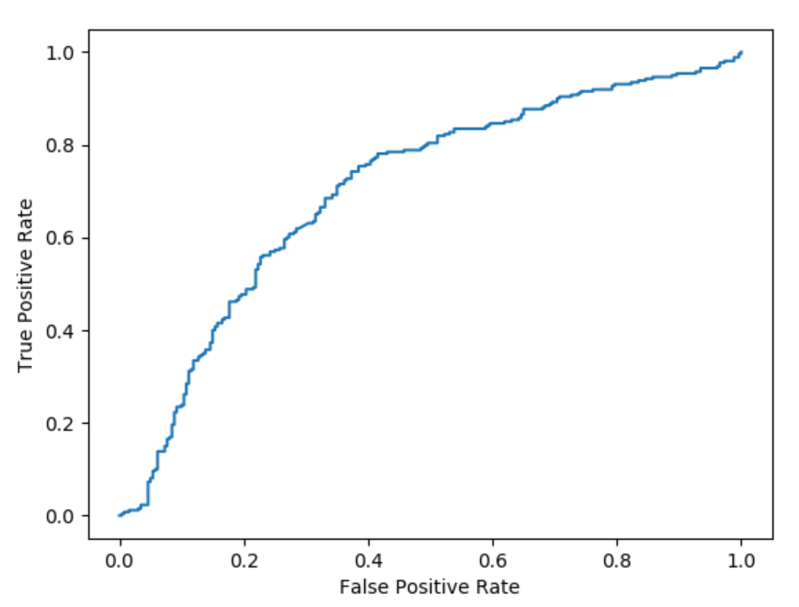
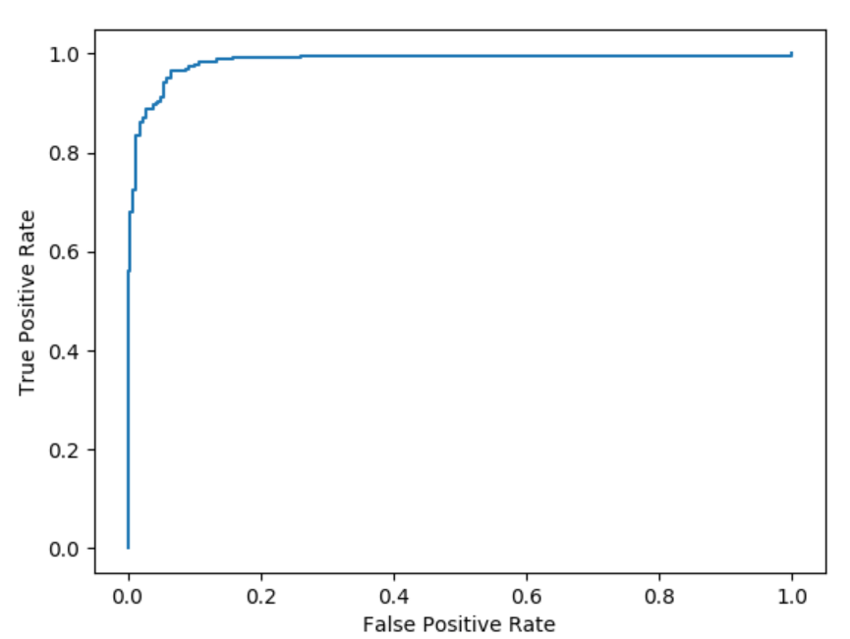
Feature Sequence = 100 Frame, Overlap = 10 Frame
Head wrt. Camera | Head Rotation | Gaze | Blink | Lips
Obama
Trump

Slide 5
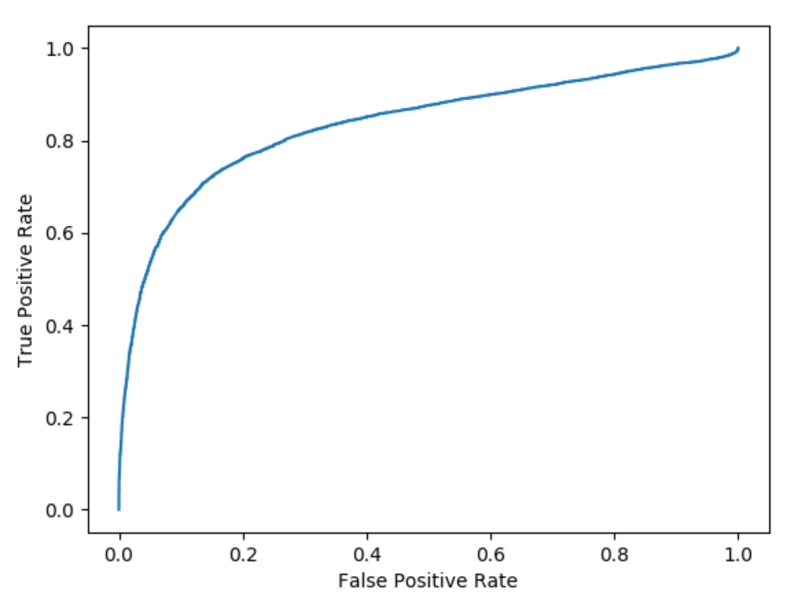
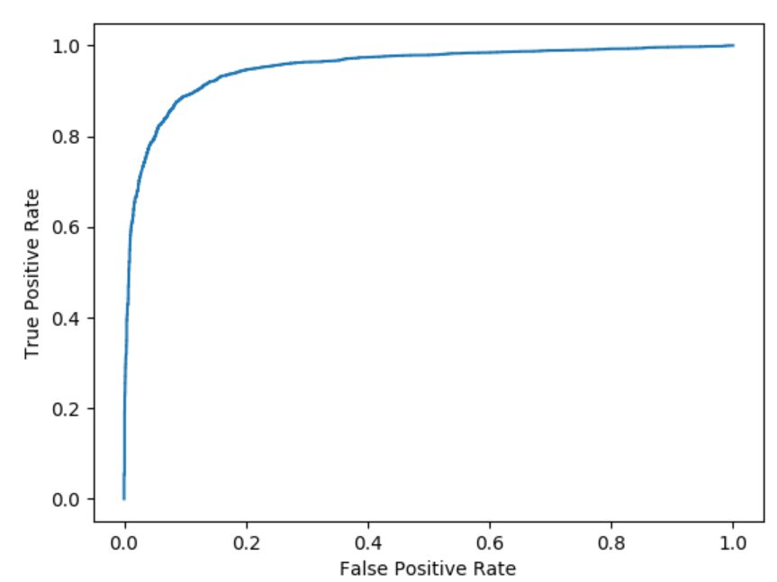
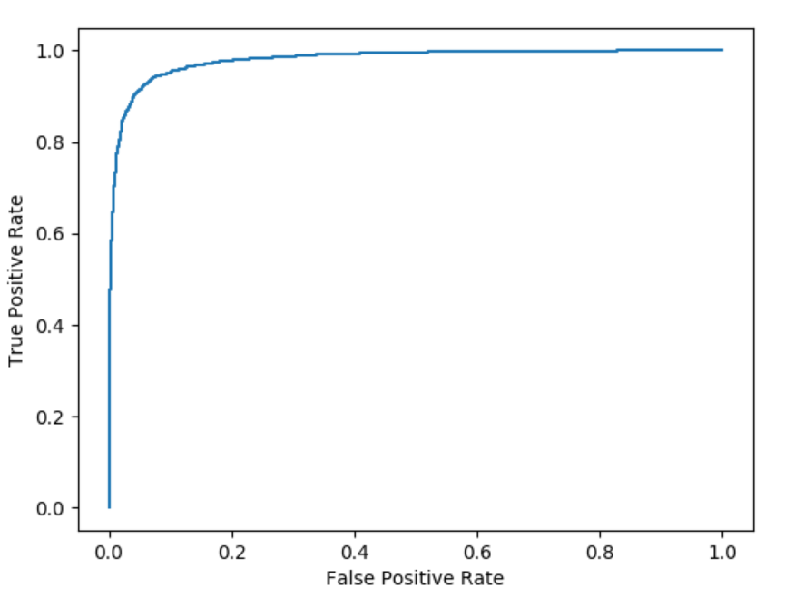
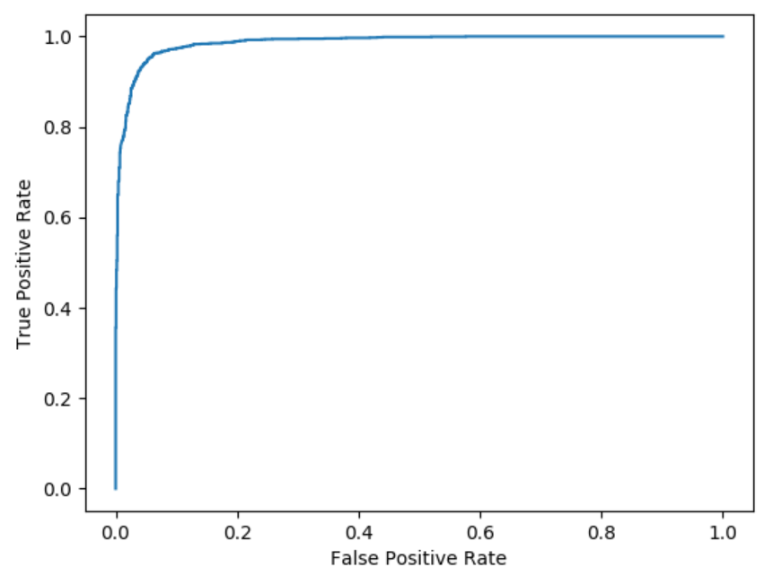
Frame Length Trump, with Lips feature only
Frame | Overlap | Accuracy
10 | 1 | 0.834136
30 | 3 | 0.952445
50 | 5 | 0.979988
70 | 7 | 0.98664519
100 | 10 | 0.992473
Frame | 10 | 30 | 50 | 70 | 100
Overlap | 1 | 3 | 5 | 7 | 10

